Slide 1





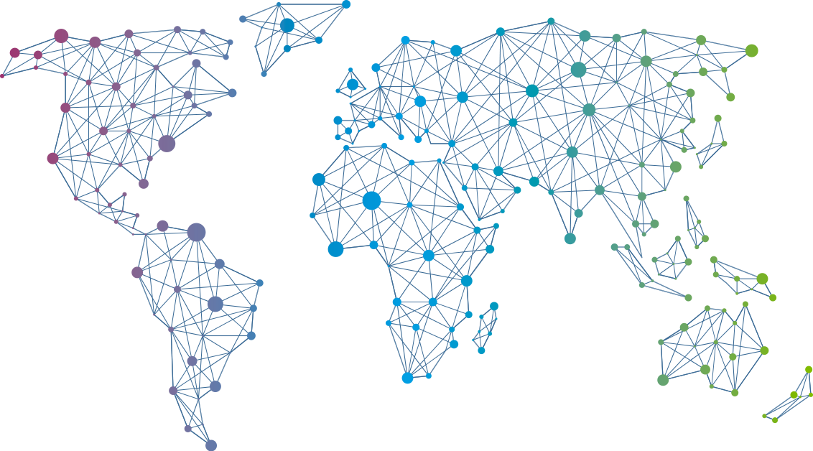

Speaker
Amber Erickson
PowerShellGet: Today and Tomorrow
Amber Erickson
amberlerickson
September 16th & 17th
^{Online Event}
Powered By
International Conference

